Slide 1


Supporting Grieving Students in Schools:
Training Module - 3
Notes:
Version August 2019
This “Supporting Grieving Students in Schools” training was divided into three sections or modules so that this education program can be taught in three separate presentations.
The first module will help school staff understand the experience of the grieving student and includes information about how children understand death and express their grief.
The second module presents practical suggestions about how school staff can initiate the conversation and offer support to the grieving student.
This is the third module. This module presents practical guidance about how to coordinate resources and manage special issues while you support the grieving child.
At the bottom of some of the notes, three stars (***) will alert you about a location on the www.grievingstudents.org website where you can find video presentations and testimonies about the topic being presented.

Slide 2
Practical Considerations
This module will provide information about how school staff can
Provide advice on Funeral Attendance for Families
Connect With Grieving Families
Coordinate School Team Services
Foster Peer Support
Inform Staff and Students About a Death
Prepare for a Crisis
Use Social Media Following a Death
Set Goals for School Staff following a Suicide
Respond When a Teacher or Other Staff Dies
Provide Support through Memorials & Commemorative Activities
Focus on Professional Self-Care
Notes:
Practical considerations sometime require adaptation of existing policies and practices to meet the needs of the grieving child, class, school and family.
This is the 3rd of 3 modules. This module will provide information about how school staff can:
Provide advice on Funeral Attendance for Families
Connect With Grieving Families
Coordinate School Team Services
Foster Peer Support
Inform Staff and Students About a Death
Prepare for a Crisis
Use Social Media Following a Death
Set Goals for School Staff following a Suicide
Respond When a Teacher or Other Staff Dies
Provide Support through Memorials & Commemorative Activities
Focus on Professional Self-Care
At the bottom of some of the notes, three stars (***) will alert you about a location on the www.grievingstudents.org website where you can find video presentations and testimonies about the topic being presented.

Slide 3
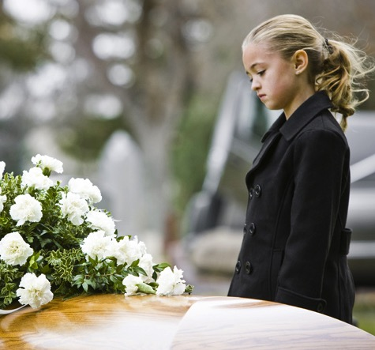
Providing Advice on Funeral Attendance for Families
Explain what will happen
Answer questions
Let children decide
Pair an adult with each child
Allow options
Offer a role
Check in afterward
Notes:
It’s important to offer children a chance to attend funeral or memorial services after the death of a family member or a loved one. Most of the time, it’s better for children if they do attend. School personnel often have a chance to play a vital role in helping families make good choices about children’s participation in services. Often, school personnel are the only professionals who interact with families before the funeral.
It is important for children to understand beforehand what is likely to occur at the funeral. School staff can share the following guidelines with families to help them prepare and support children attending services:
• Explain what will happen. In simple terms, describe what the service will be like. For example, talk about where it will be held, who will be there, the sequence of events, and what people might say or do. Will there be laughter? Tears? Stories? Music and singing? Will the casket be present? Will it be an open casket? Will there be a funeral procession or a graveside service?
• Answer questions. Invite children to ask questions at any point over the days leading up to, as well as during and after the service. Check in with children several times over this period.
• Let children decide. Give children choices—to attend the services or not, to participate actively or sit quietly, or to stay for the entire service or part of it. It’s helpful to tell children they can leave the service at any point, or take a break for a short time if they wish.
• Pair an adult with each child. Especially for young children and preteens, find an adult who can stay with the child throughout the service. This adult can answer questions, provide support and comfort, and accompany the child if he or she wishes to leave for a period of time. Ideally, this will be someone known to the child, but not deeply affected by the death. A babysitter or neighbor often works well. Teachers can also offer to fulfill this role.
• Allow options. Help children find ways to be present at the service that feel safe and meaningful. Young children might want to play quietly on one side of the room. Teens might want to invite a close friend to sit with them in the family section.
• Offer a role. When the service is for a family member, offer the child an opportunity to play a role in the service. Choose simple options that are a good match for the child’s age and personality. They may wish to select music, read a poem, pass out memorial cards, light candles, or perform some other activity. It’s also fine if the child prefers not to participate actively in the service.
• Check in afterward. Ask children what they thought of the service and how they are feeling about it. Find out if they have any questions. Check in periodically over several days. Teachers can also check in with students after they have attended a service.
*** Funeral Attendance
https://grievingstudents.org/module-section/funeral-attendance/

Slide 4
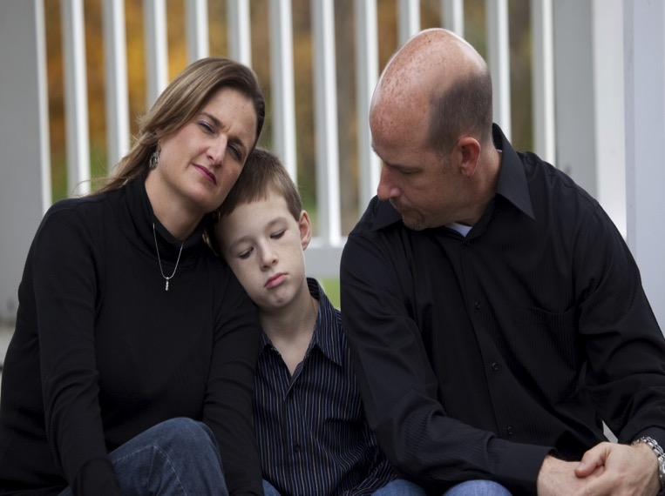
Connecting With Grieving Families
Express condolences on behalf of the school community
Determine what information they wish shared with students and staff
Check-in with the family about your efforts to support the child and ask for assistance in identifying what the child knows or does not know about the death
Let the family know the professional resources of the school are available
Offer advice on how to support grieving children
Remind parents of their critical role in supporting their children at this time
Notes:
Teachers and other school staff play a vital role when they reach out proactively to make contact with students’ families after a death. They can provide information, find out how students are doing, offer advice and assistance, and partner with families to provide support over time.
Goals for Communication With Families:
Express condolences on behalf of the school community. Recognize that some families will decline offers to meet, speak, or receive assistance —especially at first. Re-extend the invitation occasionally and keep the door open, should the family become ready at a later time.
Determine what information they wish shared with students and staff. Grieving families may need guidance about how important it is to share information about a death. Clear information can help prevent the spread of rumors and misinformation.
Check-in with the family about your efforts to support the child and ask for assistance in identifying what the child knows or does not know about the death
Let the family know the professional resources of the school are available. It is appropriate for schools to initiate contact with students’ families after a death occurs. Parents may be overwhelmed by events and may not think of their children’s school as a resource for information, guidance, and support.
Offer advice on how to support grieving children. Parents may appreciate guidance on what to say to their children about the death. School personnel are often involved early enough to provide advice on funeral attendance.
Remind parents of their critical role in supporting their children at this time. Let parents know their children may be worried about them, and are looking to them for guidance on how to cope. You may be able to equip the family with needed information and advice that allows them to better fulfill this role.
*** Connecting With Families
https://grievingstudents.org/module-section/connecting-with-families/

Slide 5
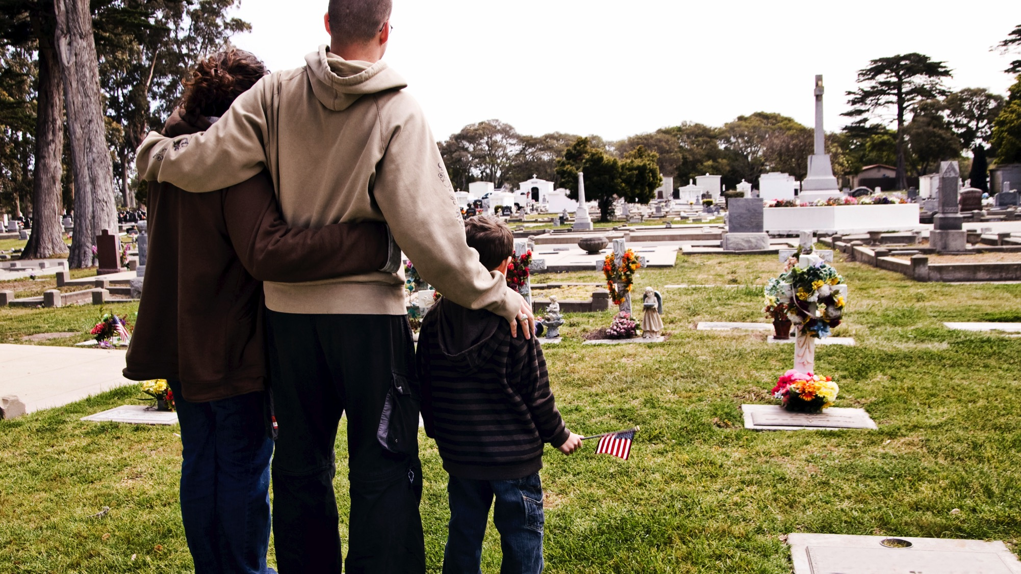
Assist with transition of the student back to school
Seek feedback from parents about their children
Offer information about community resources that may be of help to everyone in the family
Identify and anticipate potential challenges
Partner with families to support children over time
Provide appropriate reassurance and positive feedback
Notes:
Assist with transition of the student back to school. Help the family plan a timely return to school. Help prepare the student, their classmates (as appropriate), and school personnel for the student’s return.
Seek feedback from parents about their children. How are the children coping? What strategies do parents think will be helpful for school personnel in providing support over time? Parents can provide useful insights about what is, and is not, likely to work.
Offer information about community resources that may be of help to everyone in the family, such as mental health professionals and bereavement support groups. Suggest the family check with their pediatrician or other health-care provider for guidance and referrals. Help them think through other supports in their extended families and communities.
Identify and anticipate potential challenges. Families may need practical support (e.g. transportation, childcare). Schools can sometimes identify resources to address practical needs. Parents can often identify potential trigger situations for their children (e.g. significant dates, upcoming transitions).
Partner with families to support children over time. Let parents know they are helping the teacher and school better support their children—academically and emotionally—by providing useful information and valuable insight.
Provide appropriate reassurance and positive feedback. Identify ways students and families are already coping effectively. Families may feel both overwhelmed and unfamiliar with grief. They may not recognize the ways they are coping well because the children are still upset.

Slide 6
Coordinate School Team Services for the Grieving Child
Grieving Child
Nurse
Teacher
Social Worker
Administrator
Psychologist
Counselor
Maintain effective communication with the student and the family
Offer information and status updates, answer questions, provide referrals, and support grieving students over time and during periods of transition
Maintain frequent, effective contact with the student and the family
Establish one (or a few) primary points of contact for student and family
Ensure that there is at least one point of contact for every student who has experienced a significant loss
Notes:
Grieving students interact with a large number of school personnel. Ideally, all of these professionals will function as a team that coordinates services. This team should:
maintain effective communication with the student and the family.
offer information and status updates, answer questions, provide referrals, and support grieving students over time and during periods of transition.
maintain frequent, effective contact with the student and the family. The team can offer the family information, status updates, answers to questions, and responses to concerns. They can provide referrals where appropriate and partner with the family to coordinate support strategies between school and home.
establish one (or a few) primary points of contact for student and family. Families may feel overwhelmed if they are being regularly updated by many school staff members, especially if they have more than one child in the school system. Students may find many update meetings burdensome. They may not wish to discuss the impact of their loss with multiple adults at the school on a regular basis. Ideal primary contacts might be a team member who already has a special relationship with the student or one who has a greater level of comfort or experience supporting grieving students and families.
ensure that there is at least one point of contact for every student who has experienced a significant loss. This contact should be clearly and expressly identified by the team so there isn’t a mistaken assumption that “someone else is taking care of this.”
*** Coordinating Services & Supporting Transitions
https://grievingstudents.org/module-section/coordinating-services-supporting-transitions/

Slide 7

Fostering Peer Support - Equip Students With Skills
Provide information
Give students an opportunity to ask questions
Provide a safe environment for students to share thoughts and feelings
Offer concrete advice and practical suggestions
Notes:
Children who are uninformed or unprepared may unintentionally isolate or tease a classmate after a death. This can worsen the isolation grieving students already feel. But children naturally want to help their friends. Teachers can equip their students with the skills to support a peer. This can make a profound difference for a grieving student.
When teachers take the following steps, students are more likely to provide effective support to a grieving peer:
Provide information. Help students understand, at a very basic level, what has happened. They will be less likely to burden a grieving peer in the immediate aftermath of a death with repetitive questions.
Give students an opportunity to ask questions. Students are likely to have questions about what death is and the effect it has on children and their families. They will want to know how to be helpful to someone who is grieving. Teachers can often discuss this information with a class before the grieving student returns to school. This helps everyone feel more prepared.
Provide a safe environment for students to share thoughts and feelings. Invite students to talk about their own losses or the fears they may have about someone in their own life dying.
Offer concrete advice and practical suggestions. For example, talk about ways to start a conversation with someone who is grieving
*** Peer Support
https://grievingstudents.org/module-section/peer-support/

Slide 8

Informing Staff About a Death
What is known about the death
How to discuss the event with students
What supportive services will be available for students and staff
Any changes in the school’s schedule for the day
Copies of communications that will be sent to parents and guardians
Notes:
Information about the death of a member of the school community is likely to spread quickly among students and staff. This increases the likelihood of rumors, misinformation, and gossip. This is one reason it is important to notify the entire school community, at the same time, as soon as possible after information is known about a death. If a death occurs outside of school hours, consider holding a meeting of school staff before the start of the next school day.
Staff should be informed about:
what is known about the death.
how to discuss the event with students. Guidelines for making the announcement to students can be distributed.
what supportive services will be available for students and staff.
any changes in the school’s schedule for the day.
copies of communications that will be sent to parents and guardians can also be shared at this time.
Sample notification letters and announcements that can be downloaded and adapted by schools are available at www.schoolcrisiscenter.org or by following links within the Guidelines for Responding to the Death of a Student or Staff, or Guidelines for Schools Responding to a Death by Suicide, located in the Additional Resources section of www.grievingstudents.org.
*** Death and School Crisis
https://grievingstudents.org/module-section/death-school-crisis/

Slide 9

Informing Students About a Death
At the same time, as soon as possible after the start of the school day
By someone familiar to the students
In person, in small, naturally occurring groups such as homerooms or classrooms
In a setting and at a time where immediate support is available
Notes:
Students should be informed:
At the same time, as soon as possible after the start of the school day. It is important to make sure that students and staff who are off-site for the day—on field trips or home sick, for example—are also notified as soon as possible. Schools should also plan a process for notification should a death occur during a weekend, holiday, or vacation period. Over a longer vacation period, the school may decide to open for specific periods of time to offer a supervised location where students can come together and get support.
By someone familiar to the students. The person giving the notification can observe students’ reactions and answer questions as they arise.
In person, in small, naturally occurring groups such as homerooms or classrooms. Announcements in large assemblies or over public address systems are not recommended.
In a setting and at a time where immediate support is available to them. Schools should avoid notification at dismissal. Even if staff members are available to students after dismissal, not all students are able to stay after school hours to access those supports.

Slide 10
Prepare for a Crisis
Critical to have plans in place prior to a school crisis event which outline the steps for staff and students to take in response to the event and to have relevant policies in place
Establish pre-existing relationships with organizations and professionals outside the school who can be called upon with short notice to provide needed support
Crisis
Before
After
Notes:
When a death directly affects many people in a school community, a large number of students and staff may benefit from supportive services. Current staff may find it difficult to meet all of these needs, especially if they, too, are grieving. It is therefore critical to have plans in place prior to a school crisis event which outline the steps for staff and students to take in response to the event and to have relevant policies in place.
In addition, schools might consider establishing pre-existing relationships with organizations and professionals outside the school who can be called upon with short notice to provide needed support.
*** Death and School Crisis
https://grievingstudents.org/module-section/death-school-crisis/

Slide 11

Use of Social Media by Schools Following a Death
A highly effective means to rapidly disseminate information to the school community as a whole
Offers a way to reach out to grieving families or students in the initial period after a death, if the family is not yet ready to accept calls or visitors
Offers insight into how people are responding to a death
Used to facilitate commemoration and memorialization efforts
Notes:
Social media is a powerful influence in young people’s lives. When a death of a member of the school community occurs, information can be passed quickly among students—sometimes accurate, sometimes not. Grieving students can obtain considerable support from peers and school through social media. It is important for school professionals to consider how to best adapt the use of social media when a death has occurred, and understand how to use it optimally.
Social media:
Can be a highly effective means to rapidly disseminate information to the school community as a whole. When appropriate, this outreach can include recent graduates who may have known the person who died, but are now living in other locations for work or college.
Offers a way to reach out to grieving families or students in the initial period after a death, if the family is not yet ready to accept calls or visitors.
Offers insight into how people are responding to a death. Information being shared among students and staff through social media can help inform plans to provide support to the community. Schools need to develop policies concerning the monitoring of social media. It is important to find a balance that precludes infringing on privacy but allows information expressed through social media to be acted on if necessary to preserve safety—for example, if an individual is expressing suicidal intentions.
Can be used to facilitate commemoration and memorialization efforts.
*** Social Media
https://grievingstudents.org/module-section/social-media/

Slide 12

Suicide
Death by suicide is the third leading cause of death in children ages 10–14 & the second leading cause of death in children ages 15–19
Almost one in five high school students has considered suicide, and 2% to 6% of children attempt suicide
Suicide is usually the result of underlying depression or other mental health problems and often is related to alcohol or other substance abuse
Notes:
It is highly likely that many members of the school community, students as well as staff, have personal experiences with suicide among family or friends. Also, anyone might have considered or attempted suicide in the past—you cannot tell by looking at or talking with someone. Important facts to remembers about child suicide:
Death by suicide is the third leading cause of death in children ages 10–14 & the second leading cause of death in children ages 15–19.
Almost one in five high school students has considered suicide, and 2% to 6% of children attempt suicide.
Suicide is usually the result of underlying depression or other mental health problems and often is related to alcohol or other substance abuse.
*** Suicide
https://grievingstudents.org/module-section/suicide/

Slide 13

Setting Goals for School Staff following a Suicide
Talk with the surviving family about sharing the cause of death
Have clear communication with students
Help students & staff navigate the process
Explain to students about the danger of keeping secrets
Use sensitivity when deciding how to commemorate the death
Take steps to prevent another suicide
Notes:
Setting Goals for School Staff following a Suicide:
Talk with the surviving family about sharing the cause of death. Because of the stigma and pain of suicide, survivors often experience strong feelings of guilt, shame, regret, and anger. Families may not wish suicide mentioned as a possible or likely cause of their child’s death, even when circumstances suggest otherwise. When possible, explain to the family that an honest, sensitive discussion about the cause of death with students may decrease the risk that others will die by suicide.
Have clear communication with students. Effective and appropriate communication about a death by suicide is important in order to reduce the risk of other students or members of the community engaging in self-harm or attempting suicide. In presentations to students, it’s important to de-stigmatize seeking help for depression, other mental health problems, and substance abuse. Emphasize that while thoughts of escape through suicide may be fairly common—many people have such thoughts at some point in their lives—these thoughts are normally set aside by clear thinking. Self-destructive behaviors occur when a person is not able to think clearly and are often the result of impaired problem-solving abilities.
Help students & staff navigate the process . It is important to recognize that talking about suicide will not cause students who otherwise wouldn’t have to consider self-harm. Mental health and counseling staff of the school, as well as community-based partners, can serve as excellent resources to support classroom interventions. It is important to offer support resources for school staff as well. Provide information about suicide hotlines and related resources within the school and community.
Explain to students about the danger of keeping secrets. Peers often know when a friend is thinking of self-harm. They are often asked to keep this information confidential. Explain that just as true friends don’t allow their friends to drink and drive, they should never agree to keep suicidal intentions secret. Emphasize that this advice is intended to help prevent future deaths by suicide, not to make people feel guilty if they had concerns or information about someone who completed a suicide and chose not to bring that to an adult’s attention.
Use sensitivity when deciding how to commemorate the death. Death by suicide should not be sensationalized or glamorized. On the other hand, it is important to acknowledge the grief of survivors who lost a friend and classmate and to guide students toward resources for support. Discussions with students should be geared toward remembering what made the student special, and not emphasize the way the student died. Avoid formal acts that recognize and memorialize someone in the school community who has died by suicide.
Take steps to prevent another suicide. Those closest to the deceased should be given additional support at this time. So should individuals who believe they may have neglected or mistreated the person who died. They may feel guilt themselves or be targeted and blamed by peers—for example, an ex-girlfriend who just ended a relationship with the deceased. Individuals experiencing depression, those who have contemplated or attempted suicide in the past, or those with family members who died by or are at risk for suicide may also have more difficulties and warrant additional support. School counselors, school nurses, school psychologists, and school social workers can help teachers and other school staff identify risk factors and signs of distress among individual students that may indicate the need for mental health services beyond what is offered in the school.

Slide 14

Responding When a Teacher or Other Staff Member Dies
Assign a well-known member of the school community to cover that person’s classes and activities
When a colleague dies, teachers and other staff often feel an increased sense of vulnerability
Support staff who want to attend the funeral
Students and staff should not feel any obligation to attend the funeral
Explore the possibilities for visitation hours that will best serve both the grieving family and the school community
Notes:
If a teacher or staff member dies:
Assign a well-known member of the school community to cover that person’s classes and activities. This might be another teacher from the same grade level, a teacher from the prior grade, or a well-liked administrator or assistant.
When a colleague dies, teachers and other staff often feel not only grief, but an increased sense of vulnerability.
Support staff who want to attend the funeral.
Students and staff should not feel any obligation to attend the funeral.
Explore the possibilities for visitation hours that will best serve both the grieving family and the school community. The family may be able to arrange visitation hours outside of school time, for example. They may choose to move the services to a larger location. In some cases, there may not be enough room at the funeral location for all who wish to attend. Schools can plan alternative gestures for interested students and staff. They might gather outside the facility before the service to show their caring and remembrance to the family, or do activities in small groups at the school that allow them to share their thoughts with each other and possibly with the family of the deceased.

Slide 15

Providing Support through Memorials & Commemorative Activities
• Communicate at a public level their connection and attachment
• Express and cope with difficult feelings
• Realize that they are not alone in having strong feelings
• Draw on the support of peers and adults in the school community
• Begin to find some meaning in the loss
• Feel reconnected to beliefs that may have been shaken by the experience
• Learn coping strategies that have worked for others and share their own
Notes:
Memorial and commemorative activities can be helpful to students and staff. When a death occurs in the school community, these activities help students to:
communicate at a public level their connection and attachment
express and cope with difficult feelings
realize that they are not alone in having strong feelings
draw on the support of peers and adults in the school community
begin to find some meaning in the loss
feel reconnected to beliefs that may have been shaken by the experience
learn coping strategies that have worked for others, and share their own
*** Commemoration and Memorialization
https://grievingstudents.org/module-section/commemoration-and-memorialization/

Slide 16

School-Sponsored Memorial & Commemorative Activities
Allow students to play a central role in the planning and development process
Be respectful of the diversity of views & needs of students and staff
Ensure policies are capable of being readily applied fairly and consistently across a wide range of contexts
Coordinate with plans for commemorative or memorial activities in the larger community
Notes:
Schools should give careful consideration to ensure that any policies and procedures followed to commemorate a death support the needs of the students who are grieving as well as heed safety concerns.
For these activities to be helpful:
Allow students to play a central role in the planning and development process. This ensures that the activities are relevant to students’ interests and responsive to their needs. Simply stated, a commemorative or memorial event planned by adults for children is likely to be helpful to the adults rather than the children. When children plan and take part in these activities, they can exercise some control over how they choose to remember and honor the person who died. Helping children feel some sense of control over the response to the death lessens these feelings.
Be respectful of the diversity of views & needs of students and staff.
Ensure polices are capable of being readily applied fairly and consistently across a wide range of contexts
Coordinate with plans for commemorative or memorial activities in the larger community.

Slide 17
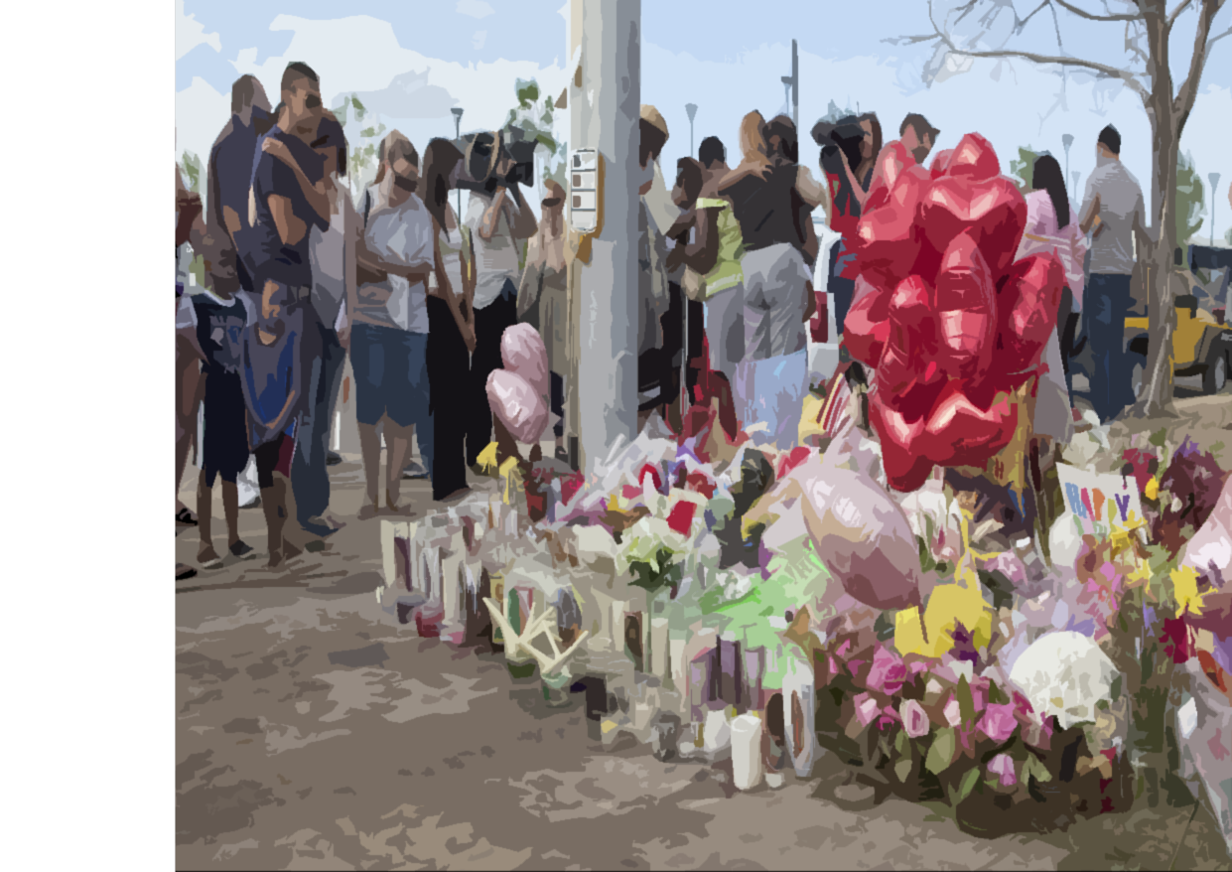
Set appropriate precedents
Allow time to pass before
decisions are made
Make use of social media
Manage spontaneous memorials
Schools should notify families
of students in the class or school
prior to memorial events or planning efforts
Children who are uncomfortable about attending a memorial, or prefer not to participate, should feel free to choose not to go
Notes:
Set appropriate precedents. Generally avoid legacy memorials, such as placing a plaque in the hallway or planting a tree, or choosing a memorial effort that requires raising substantial funds. These are precedents that the school won’t wish to apply consistently to all possible future deaths.
Allow time to pass before decisions are made. It is important to allow sufficient time and space in which members of the school community can identify and understand their thoughts and emotions about a death. Often, students and staff rush to plan commemorative and memorial activities, sometimes beginning such discussions hours, or even minutes, after hearing the news of the death. However, this rush to commemoration may divert attention from addressing the acute emotional needs of the broader school community.
Make use of social media. Students increasingly utilize social media as a means to commemorate and memorialize those who have died. It is important that schools be aware of any such sites used or visited by students for this purpose. Ask students to bring any comments that are worrisome, destructive, or troubling to the attention of an adult—for example, suicidal or homicidal intentions, or comments about the deceased that are highly critical.
Manage spontaneous memorials. When schools do not engage students in the process of planning for commemorative and memorial activities, there is a greater risk that spontaneous, informal memorials will appear in the school or community. When this happens, it is important to communicate appropriate limits. Monitor the site regularly. Inappropriate material, whether written comments or objects, should be removed promptly. Discuss with students how long such a memorial will be left in place (generally, a few days to a week). Let them know when they may have access to the memorial and what will happen with the items left at the site.
Schools should notify families of students in the class or school prior to memorial events or planning efforts. This allows parents the chance to bring relevant family experiences to the school’s attention and to have prior discussions at home with their children about the ways the school will memorialize the life of the deceased.
Children who are uncomfortable about attending a memorial, or prefer not to participate, should feel free to choose not to go.

Slide 18

Professional
Self-Care Focus
Notes:
Because school professionals care so deeply about students, offering support to grieving children can be both deeply gratifying and demanding. Providing support means bearing witness to students’ pain. It is critical that school professionals take care of themselves and their colleagues in ways that recognize the challenges of this work.
There are few ways to have a more meaningful and lasting impact on children than providing support as they cope with one of life’s most difficult challenges. In supporting grieving children, teachers connect with students in a powerful and qualitatively different way. It can be gratifying to see that relatively modest efforts to offer compassion and support have a dramatic effect on children. This support can help reduce the amount of time grieving children feel isolated, confused, or distressed.
*** Professional Preparation
https://grievingstudents.org/module-section/professional-preparation/

Slide 19

Possible Grief Triggers for School Staff
Past personal experience with grief
Coping with serious illness
Having a friend or family member who is ill
New concerns about loved ones
Notes:
Supporting grieving children can trigger a range of reactions in adults. This is especially true if a child’s loss is somehow similar to an adult’s personal experience. But even when the circumstances are quite different, the simple, powerful reality of a grieving child can raise thoughts, feelings, and memories concerning the adult’s own family and friends.
Examples of situations where adults may experience triggers include:
• A past personal experience with grief. School professionals who experienced the death of a parent during childhood may bring greater empathy and insight to their interactions with grieving students. They will also be more likely to experience a rekindling of their own memories.
• Coping with serious illness. An adult facing a life-changing or life-threatening illness may become more anxious about personal health and outcomes while comforting a student whose parent or sibling died of a serious illness such as cancer.
• Having a friend or family member who is ill. When someone close to a school professional is facing possible disability or death, a student’s grief may heighten worries or anticipatory grief reactions.
• New concerns about loved ones. Even when adults are not dealing with past deaths or current illnesses in their lives, the process of watching a child struggle to cope may heighten their own concerns about family and loved ones. A child’s grief can be a stark reminder that all life is fragile and uncertain.

Slide 20
Professional Self-Care in Schools
Identify friends, family, and colleagues to talk with
Seek additional support when guilt, resentment, or personal grief is strong or persistent
Consult with a school counselor, school nurse, school psychologist, school social worker, or other members of the school staff
Spiritual
Emotional
Occupational
Intellectual
Social
Physical
Creative
Wellness
Notes:
Being with children who are in distress can be unsettling for adults. We sense a vulnerability in children and naturally want to shield them from painful experiences. School staff can sustain their support for a grieving child if they look after their own wellness and arrange for assistance themselves. The following are some ways school staff can obtain support:
Identify friends, family, and colleagues to talk with. There may be times, however, when the support of family, friends, and colleagues is not the right match for the concerns at hand, or not sufficient on its own.
Seek additional support when guilt, resentment, or personal grief is strong or persistent.
Consult with a school counselor, school nurse, school psychologist, school social worker, or other members of the school staff.
*** Professional Self-Care
https://grievingstudents.org/module-section/professional-self-care/

Slide 21

This presentation was developed by…
David Schonfeld, M.D., University of Southern California
Thomas Demaria, Ph.D., Long Island University – C.W. Post Campus
Marcia Quackenbush, M.S., M.F.T., M.C.H.E.S.
With the support of members of the…
National Center for School Crisis & Bereavement
Coalition to Support Grieving Students
Art Credits: William T. Demaria and Daniel Pollera
Notes:
This presentation was developed by the National Center for School Crisis and Bereavement, located at the University of Southern California School of Social Work.
August 2019 version.

Slide 22





For further information about NCSCB visit us, call us, like us, share us:
1-888-53-NCSCB (1-888-536-2722)
www.SchoolCrisisCenter.org | info@schoolcrisiscenter.org
facebook.com/schoolcrisisorg
@schoolcrisisorg
National Center for School Crisis and Bereavement

Slide 23


Notes:
The Coalition to Support Grieving Students was convened by the New York Life Foundation and the National Center for School Crisis and Bereavement, which is led by pediatrician and childhood bereavement expert David J. Schonfeld, M.D.
The efforts of the Coalition have led to the establishment of a unified voice in ways schools can support grieving students. The www.grievingstudents.org website features a variety of training resources including videos, handouts and links to additional resources.

Slide 24
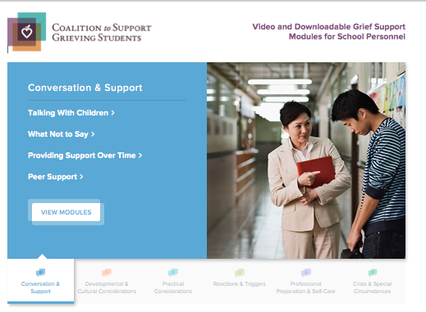
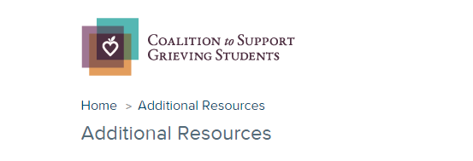
* Six topic sections contain 2 - 4 video modules with each video accompanied by downloadable handouts that summarize the major points covered.
* Links to additional resources for schools and families
www.grievingstudents.org
Notes:
The website grievingstudents.org is an innovative multimedia resource designed to empower educators and school professionals in their efforts to support grieving students.
The website offers information in six topic sections important to schools in their work to support grieving students:
Conversation and Support
Developmental and Cultural Considerations
Practical Considerations
Reactions and Triggers
Professional Preparation and Self-Care
Crisis and Other Special Circumstances
Each topic section contains 2 - 4 video modules. Each video is accompanied by downloadable handouts that summarize major points covered in the module.
Links to additional resources for schools and families are also available (https://grievingstudents.org/resources/additional-resources/) including:
Parent Booklet: After a Loved One Dies – English & Spanish
Guidelines for Responding to the Death of a Student or School Staff
Guidelines for Responding to a Death by Suicide
US DOE ERCM Express: Coping With the Death of a Student or Staff Member
Booklet: Supporting Our Students
Handout: Supporting Your Child
Teacher Training Powerpoint: Children and Bereavement: How Teachers and Schools Can Help
National and Regional Support Resources
Article: Coping With Loss
Article: School Crisis Response Initiative
Article: Talking With Children About Death

Slide 25
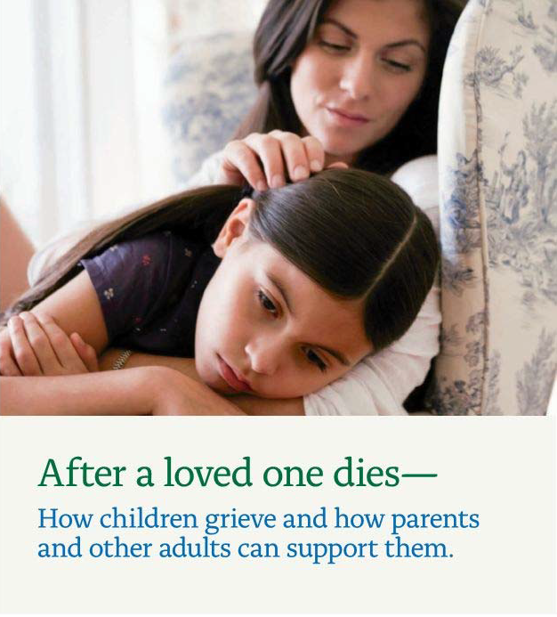

www.achildingrief.com
Schonfeld, D., and M. Quackenbush. After a Loved One Dies—How Children Grieve and How
Parents and Other Adults Can Support Them. New York, NY: New York Life Foundation, 2009.
Notes:
A free booklet for parents on how to talk to and support their children after a death can be downloaded in both English and Spanish at www.achildingrief.com.
Those looking for more detailed information may wish to read The Grieving Student: A Teacher’s Guide, published by Brookes Publishing. Teachers can be a critical lifeline for a grieving child—and now they have a practical guidebook to help them provide sensitive support to students of all ages. Educators will get the real-world tips, strategies, and insights they need to:
explain the major concepts of death in age-appropriate ways
respond constructively to children's common feelings and behaviors after a death
initiate and maintain positive, helpful communication
learn what to say and what not to say when a child or family is grieving
use simple commemorative activities at school to help students cope with their feelings
address children's responses to different causes of death, including suicide, illness, and violence
help a child who is "stuck" in a difficult phase of grief
provide ongoing assistance when triggers of grief renew a child's sense of loss
notify and support students after a death that affects the whole school community
This guide was written by David J. Schonfeld and Marcia Quackenbush and provides additional information as well as illustrative examples to expand on the information presented in this training.

